Slide 1
DATA SCIENCE Emotions Recognition
Roman Kovtunchyk

Slide 2
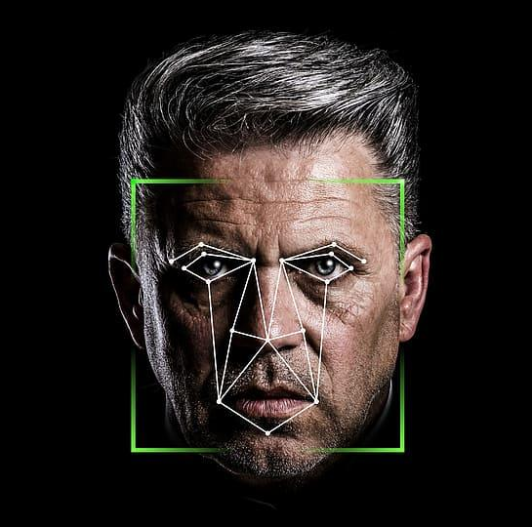
WHAT IS EMOTION RECOGNITION?
Emotion recognition is the ability of a computer to identify and interpret human emotions based on data such as facial expressions, voice, and body language

Slide 3
Why it matters?
Healthcare
Security
Entertainment
Marketing

Slide 4


Challenges and Limitations of Emotion Recognition
There are two main limitations:
Cultures
Races

Slide 5
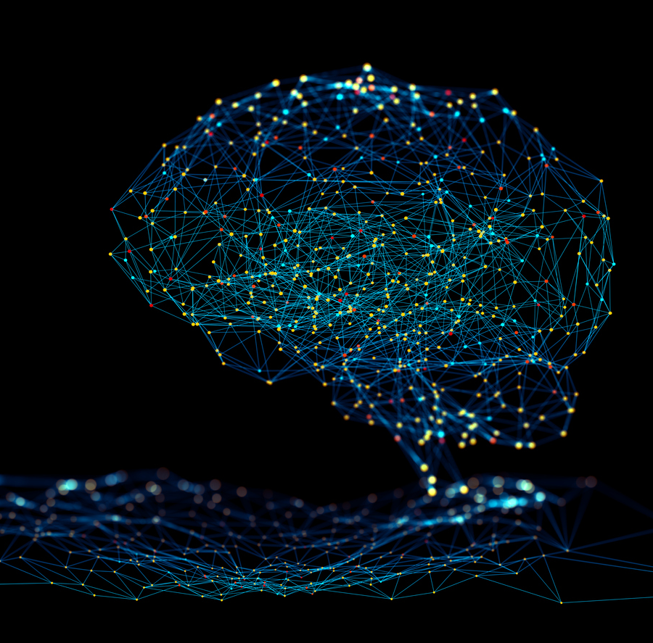
Data Collection and Preprocessing
Also, the quality of the data affects the accuracy of the prediction.

Slide 6
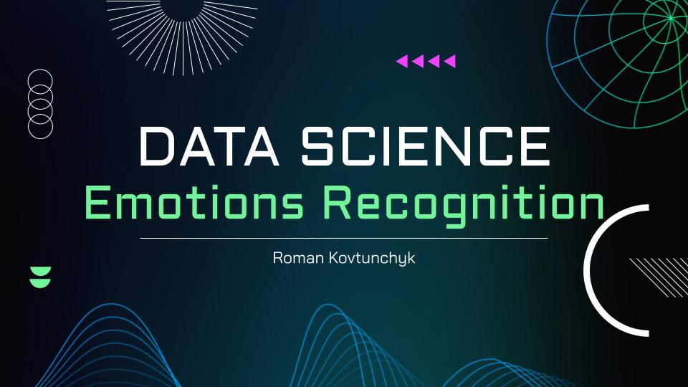
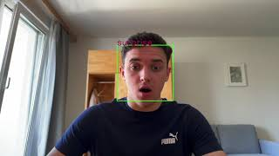
Real time video

Slide 7
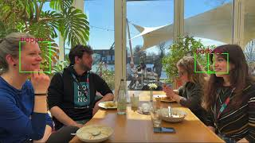
Multiple faces

Slide 8
66.7%
14.2%
My accuracy
Min accuracy

Slide 9
HOW TO INCREASE ACCURACY?
1st step
Dataset with
1 million photos
2nd step
Prepare
82%
and more
3rd step
Algorithm
4th step
More aggressive metrics

Slide 10

THANK YOU FOR YOUR ATTENTION

